Slide 1
Network Physical Structures/ Topologies
Lecture 2

Slide 2
Physical Structures
Before discussing networks, we need to define some network attributes.
Type of Connection A network is two or more devices connected through links. A link is a communications pathway that transfers data from one device to another. There are two possible types of connections: point-to-point and multipoint

Slide 3
Point-to-Point
A point-to-point connection provides a dedicated link between two devices. The entire capacity of the link is reserved for transmission between those two devices.
Most point-to-point connections use an actual length of wire or cable to connect the two ends, but other options, such as microwave or satellite links, are also possible When you change television channels by infrared remote control, you are establishing a point-to-point connection between the remote control and the television's control system.

Slide 4
Multipoint
A multipoint (also called multi-drop) connection is one in which more than two specific devices share a single link In a multipoint environment, the capacity of the channel is shared, either spatially or temporally.
If several devices can use the link simultaneously, it is a spatially shared connection. If users must take turns, it is a timeshared connection.

Slide 5
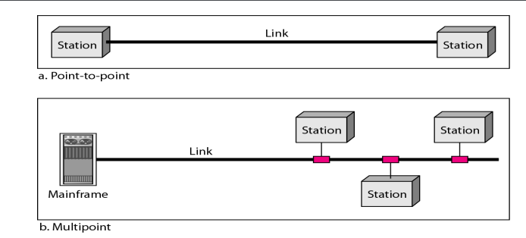
Understanding with Illustration

Slide 6
Physical Topology
The term physical topology refers to the way in which a network is laid out physically.
Two or more devices connect to a link; two or more links form a topology. The topology of a network is the geometric representation of the relationship of all the links and linking devices (usually called nodes) to one another. There are four basic topologies possible: mesh, star, bus, and ring

Slide 7
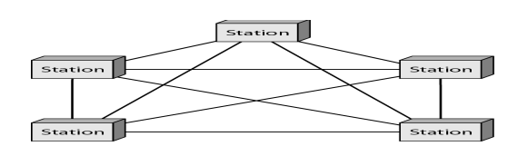
Mesh Topology
Definition
Illustration
MESH: A mesh topology is the one where every node is connected to every other node in the network.
A mesh topology can be a full mesh topology or a partially connected mesh topology.
In a full mesh topology, every computer in the network has a connection to each of the other computers in that network.
The number of connections in this network can be calculated using the following formula (n is the number of computers in the network): n(n-1)/2

Slide 8
Mesh Topology
In a partially connected mesh topology, at least two of the computers in the network have connections to multiple other computers in that network.
It is an inexpensive way to implement redundancy in a network. In the event that one of the primary computers or connections in the network fails, the rest of the network continues to operate normally.

Slide 9
Mesh Topology
Advantages
Disadvantages
Can handle high amounts of traffic, because multiple devices can transmit data simultaneously.
A failure of one device does not cause a break in the network or transmission of data.
Adding additional devices does not disrupt data transmission between other devices.
The cost to implement is higher than other network topologies, making it a less desirable option.
Building and maintaining the topology is difficult and time consuming.
The chance of redundant connections is high, which adds to the high costs and potential for reduced efficiency

Slide 10
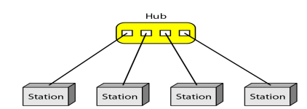
STAR
Definition
Illustration
A star network, star topology is one of the most common network setups.
In this configuration, every node connects to a central network device, like a hub, switch, or computer.
The central network device acts as a server and the peripheral devices act as clients.
Depending on the type of network card used in each computer of the star topology, a coaxial cable or a RJ-45 network cable is used to connect computers together.

Slide 11
Star Topology
Advantages
Disadvantages
Centralized management of the network, through the use of the central computer, hub, or switch.
Easy to add another computer to the network.
If one computer on the network fails, the rest of the network continues to function normally.
The star topology is used in local-area networks (LANs), High-speed LANs often use a star topology with a central hub.
Can have a higher cost to implement, especially when using a switch or router as the central network device.
The central network device determines the performance and number of nodes the network can handle.
If the central computer, hub, or switch fails, the entire network goes down and all computers are disconnected from the network

Slide 12
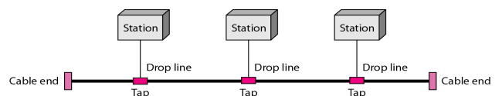
Bus
Definition
Illustration
a line topology, a bus topology is a network setup in which each computer and network device are connected to a single cable or backbone.

Slide 13
Bus topology
Advantages
Disadvantages
It works well when you have a small network.
It's the easiest network topology for connecting computers or peripherals in a linear fashion.
It requires less cable length than a star topology.
It can be difficult to identify the problems if the whole network goes down.
It can be hard to troubleshoot individual device issues.
Bus topology is not great for large networks.
Terminators are required for both ends of the main cable.
Additional devices slow the network down.
If a main cable is damaged, the network fails or splits into two.

Slide 14
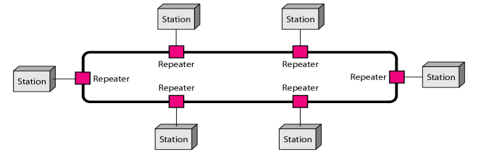
Ring Topology
Definition
Illustration
A ring topology is a network configuration in which device connections create a circular data path.
In a ring network, packets of data travel from one device to the next until they reach their destination. Most ring topologies allow packets to travel only in one direction, called a unidirectional ring network. Others permit data to move in either direction, called bidirectional. Ring topologies may be used in either local area networks (LANs) or wide area networks (WANs).

Slide 15
Ring Topology
Advantage
Disadvantage
All data flows in one direction, reducing the chance of packet collisions.
A network server is not needed to control network connectivity between each workstation.
Data can transfer between workstations at high speeds.
Additional workstations can be added without impacting performance of the network.
All data being transferred over the network must pass through each workstation on the network, which can make it slower than a star topology.
The entire network will be impacted if one workstation shuts down.
The hardware needed to connect each workstation to the network is more expensive than Ethernet cards and hubs/switches.

